Slide 1
OneParking Activity Modeling Training 02: Essentials
Kiran Mukkamala (XC-DX/EPF3)
2023-05-10

Slide 2
01
Basic Model Structure

Slide 3
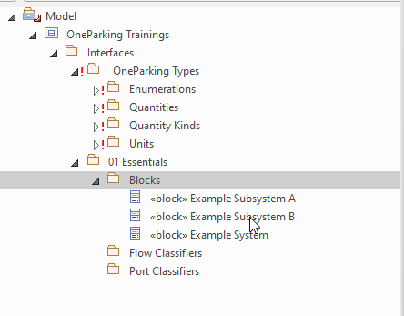
General Notes
Basic Model Structure
File:
02_Activities_Training_Essentials_Step_01.qea
NOTE:
Prerequisite: Interface Modelling Training
On a general note, make sure to save the model at each step.
By default, select SysML 1.4/1.5(do not select UML) while creating new elements.

Slide 4
02
Create Activity With An Activity Diagram

Slide 5
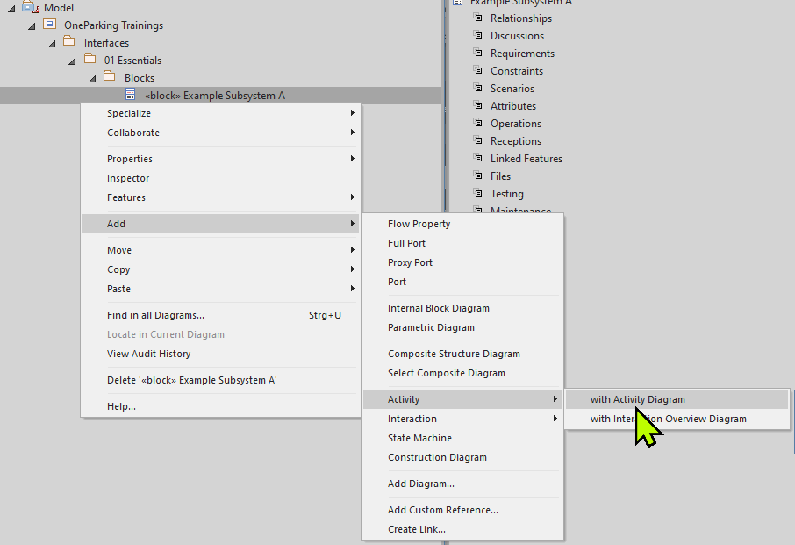
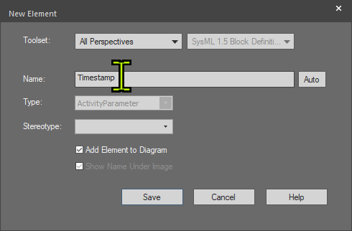
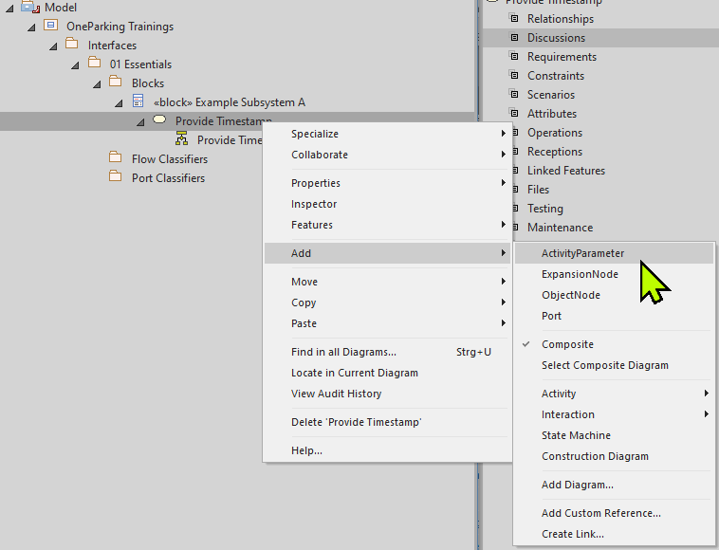
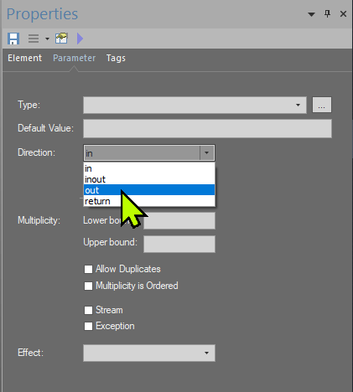
02 Part1: Adding Provide Timestamp activity
Create Activity With An Activity Diagram
Select block (Example Subsystem A), add activity with activity diagram and then name the activity as Provide Timestamp (01)
Add new activity parameter (02)
Name the activity parameter as Timestamp, check add element to diagram option (03)
Set appropriate direction(out) for activity parameter (04)
01
03
02
04

Slide 6
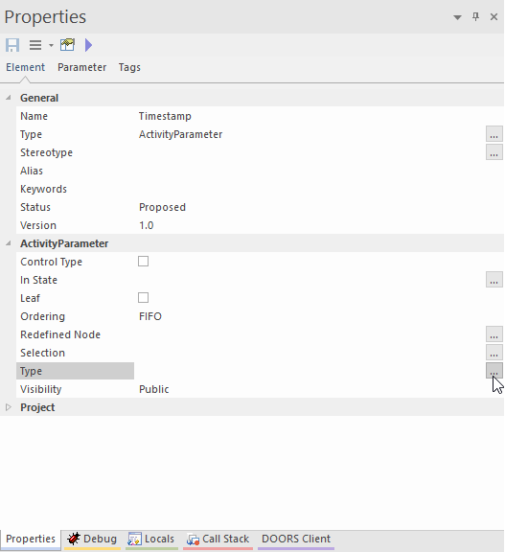
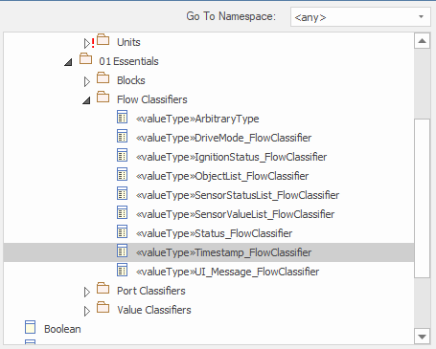
02 Part 2: Associating type to activity parameter
Create Activity With An Activity Diagram
05
Set the appropriate type (05)
Navigate in type selection window and select appropriate type for the activity parameter ‘Timestamp’ (06)
06

Slide 7
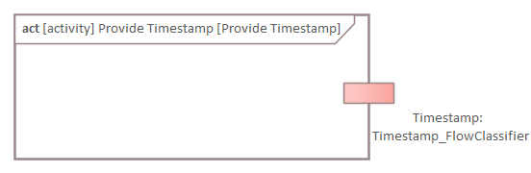
Result after Step 02
Create Activity With An Activity Diagram
02_Activities_Training_Essentials_Step_02.qea

Slide 8
03
Establishing Connections

Slide 9
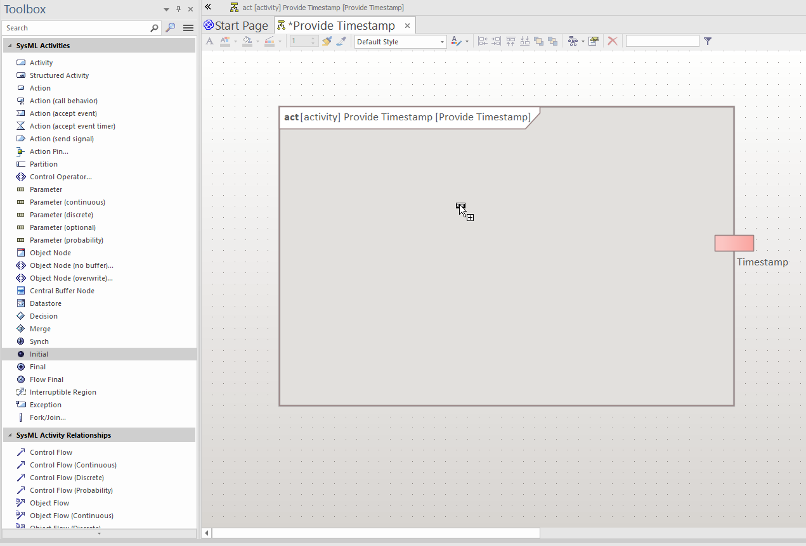
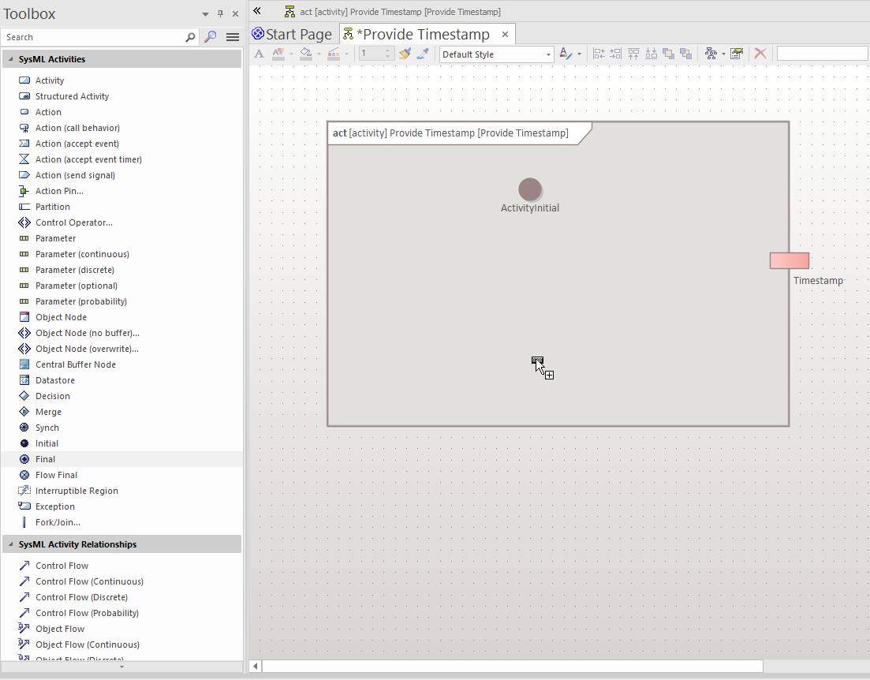
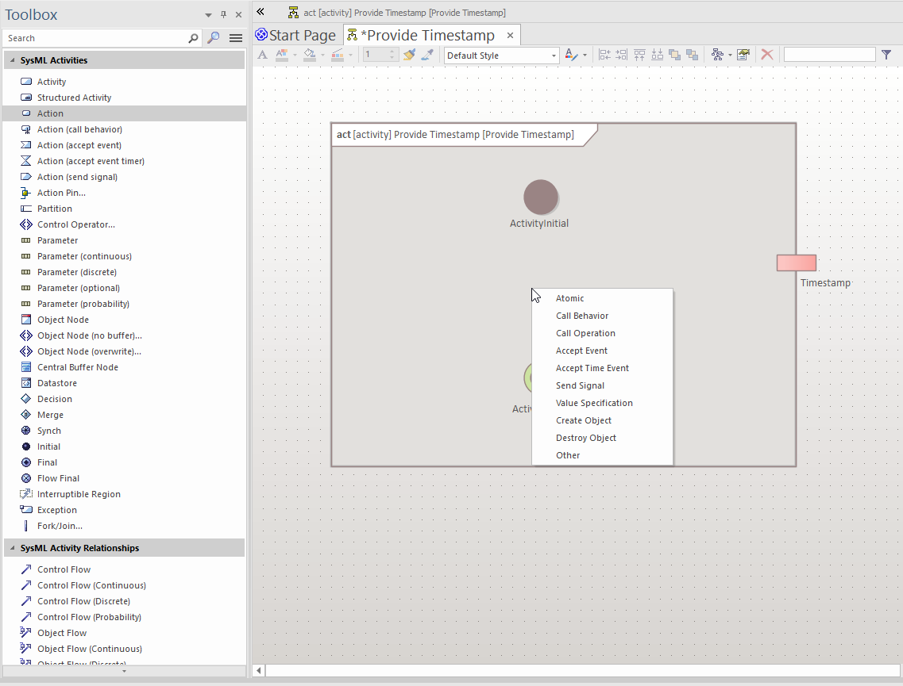
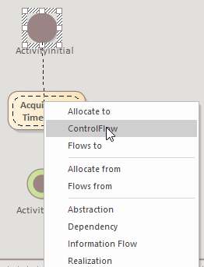
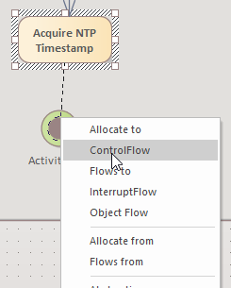
03 Adding nodes and connections
Establishing Connections
Add Activity Initial node to the Activity Diagram (01)
Add an action(select Atomic) to the Activity Diagram, rename it to Acquire NTP Timestamp (02)
Add Activity Final node to the Activity Diagram (03)
Connect Activity Initial node to the Acquire NTP Timestamp by clicking the upward arrow, hold and drag it to desired action(Acquire NTP Timestamp) or any other node. Select Control Flow as connector type (04)
01
03
02
04

Slide 10
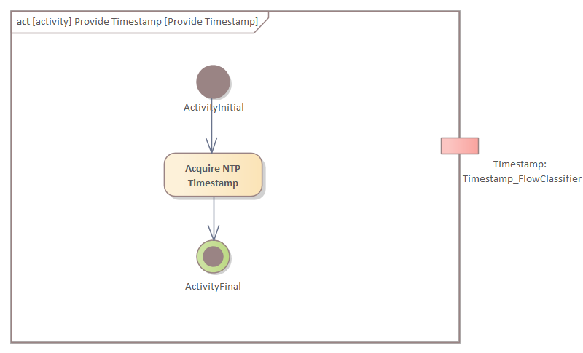
Result after Step 03
Establishing Connections
02_Activities_Training_Essentials_Step_03.qea

Slide 11
A
Exercise

Slide 12
Statement
Exercise A
Add new activity with diagram named ‘Provide Function Status’ to block Example Subsystem A
Add below Activity parameters with classifiers and direction:
Inputs
Value : SensorValueList_FlowClassifier
Status : SensorStatusList_FlowClassifier
Output
Function Status : Status_FlowClassifier
Add Initial, Final nodes followed by an Action named ‘Function Status’ to Provide Function Status activity diagram and connect these nodes as below: Inital node→ Function Status → Final node
Solution is in the next slide along with EA file

Slide 13
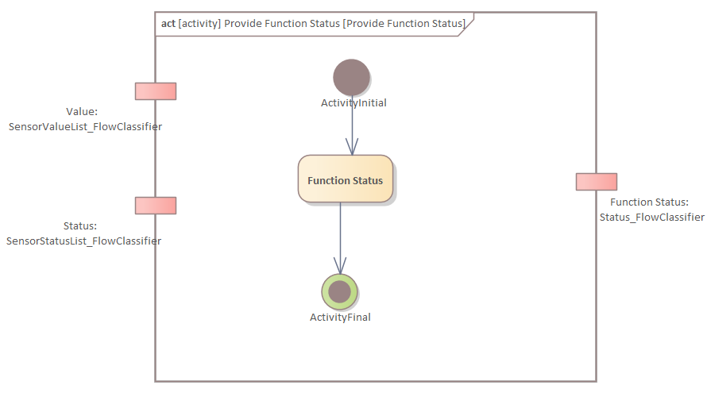
Solution
Exercise A
02_Activities_Training_Essentials_Exercise_A.qea

Slide 14
04
Adding Activity Partition

Slide 15
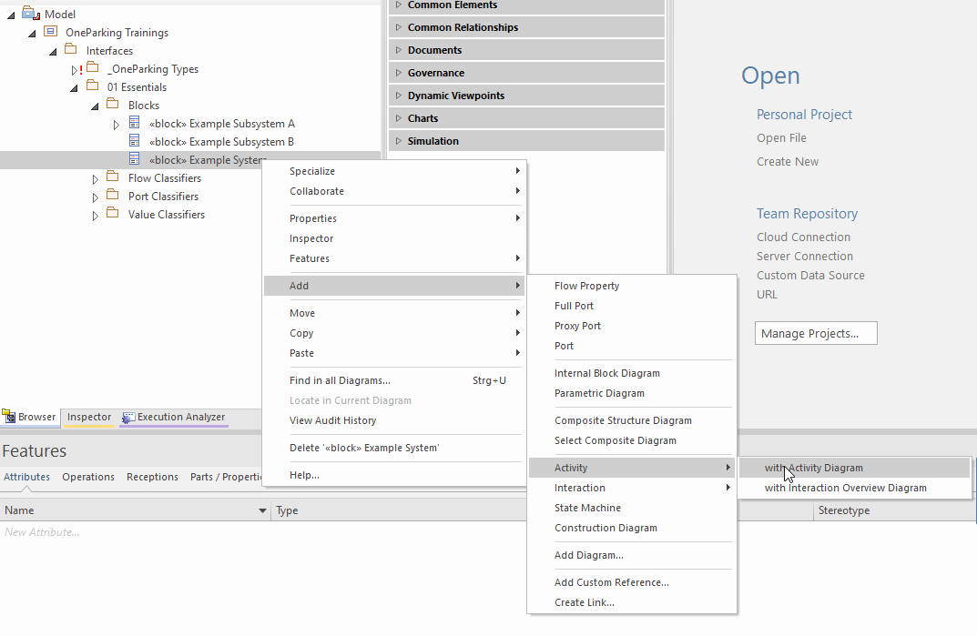
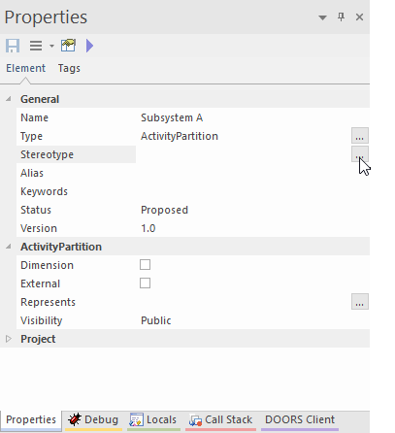
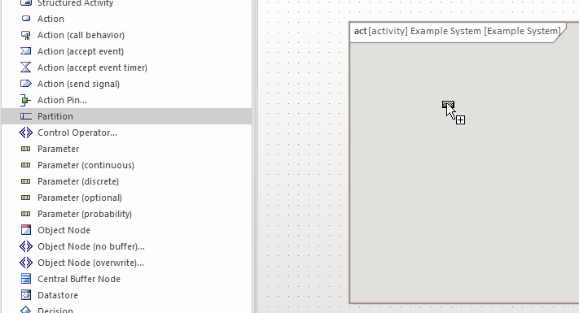
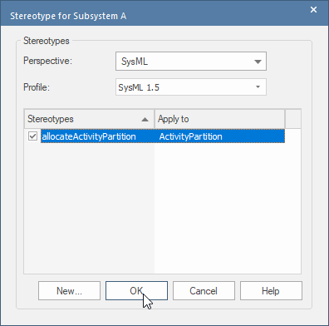
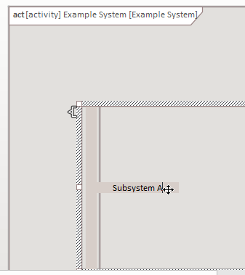
04 Adding activity partition along with allocation
Adding Activity Partition
01
Add new activity with diagram called ‘Example System’ (01)
Add an activity partition to activity diagram (02)
Rename the activity partition to desired name(SubSystem A) (03)
Click on (…) Stereotype in properties window of activity partition, select allocateActivityPartition and click OK (04)
04
02
03

Slide 16
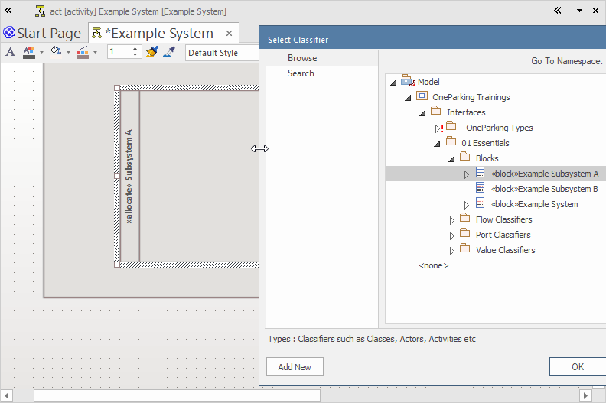
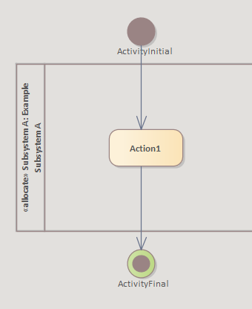
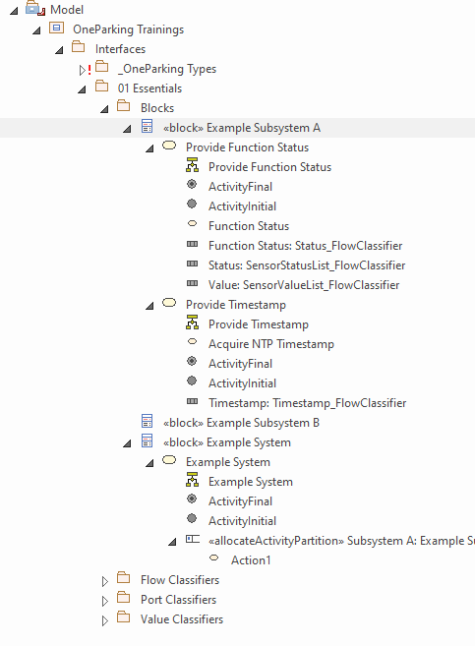
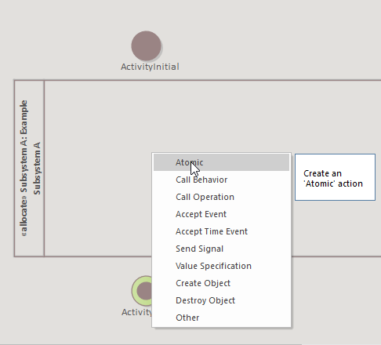
04 Associate activity partition with a subsystem
Adding Activity Partition
05
07
Select activity partition, press strg + L to get select classifier window. Navigate and select the desired subsystem block (Example Subsystem A) (05)
Add activity Initial, Activity Final node to the Activity Diagram followed by an atomic action (06)
Connect Activity Initial node to the Action1, select Control Flow as connector type (07)
Resulting Model structure (08)
Now Basic Activity Diagram is ready!!!
08
06

Slide 17
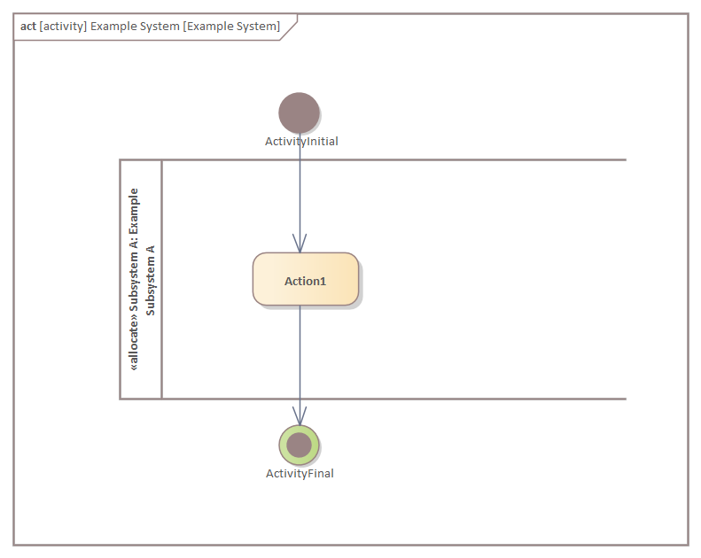
Result after Step 04
Adding Activity Partition
02_Activities_Training_Essentials_Step_04.qea

Slide 18
05
Adding Subsystem Activity

Slide 19
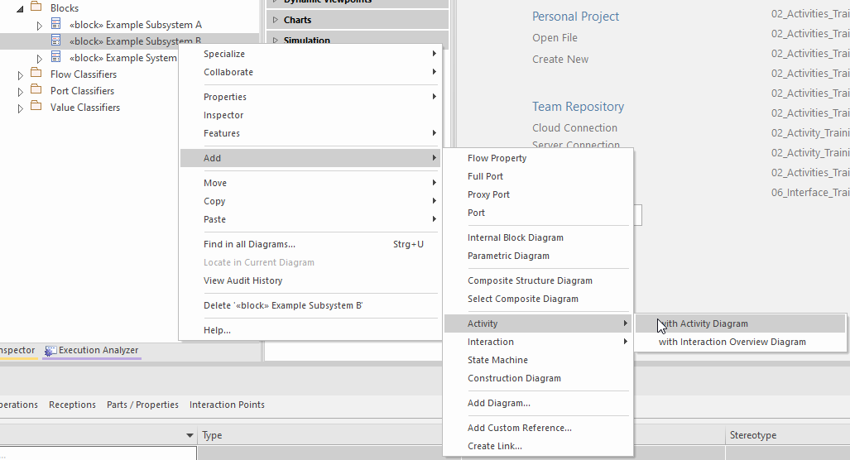
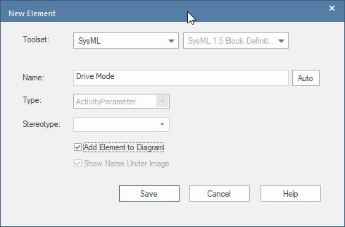
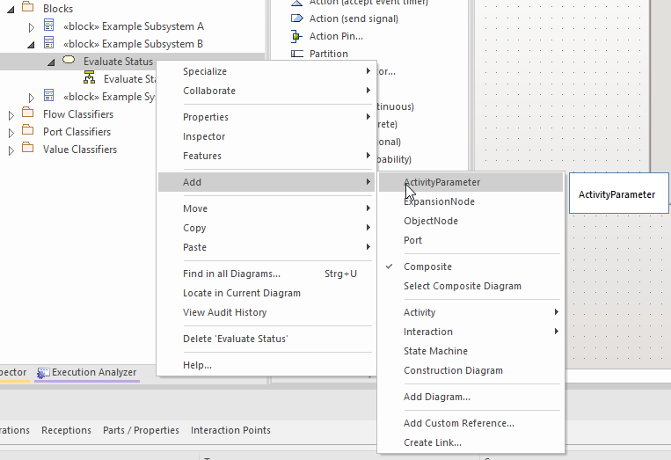
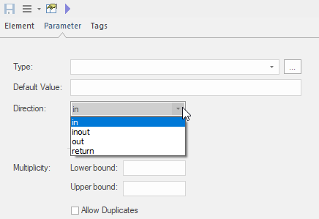
05 Adding Evaluate Status activity
Adding Subsystem Activity
Add an activity with activity diagram to Example Subsystem B, Name the activity as ‘Evaluate Status’ (01)
Add below activity parameters along with classifiers and direction: (02, 03, 04)
Inputs
Drive Mode : DriveMode_FlowClassifier
Function Status : Status_FlowClassifier
Output
UI Text: String
01
03
02
04

Slide 20
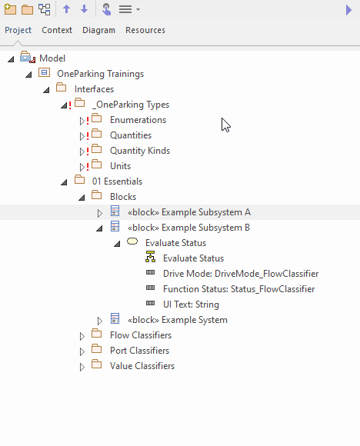
Result after Step 05
Adding Subsystem Activity
02_Activities_Training_Essentials_Step_05.qea

Slide 21
B
Exercise

Slide 22
Statement
Exercise B
Add new activity partition to Example System activity diagram and name as ‘Subsystem B’
Add an action(atomic) to activity partition Subsystem A and name as ‘Action 2’
Add an action(atomic) to activity partition Subsystem B and name as ‘Action 3’
Add below activity parameters to Example System:
Inputs
Value : SensorValueList_FlowClassifier
Status : SensorStatusList_FlowClassifier
Drive Mode : DriveMode_FlowClassifier
Output
UI Text : String
Time Stamp : Timestamp_FlowClassifier
Note: For activity parameters to appear in activity diagram, go to Features → Interaction Points check all activity parameters. Always arrange Inputs on left side, Outputs on Right side of the activity diagram for good readability.
Solution is in the next slide along with EA file

Slide 23
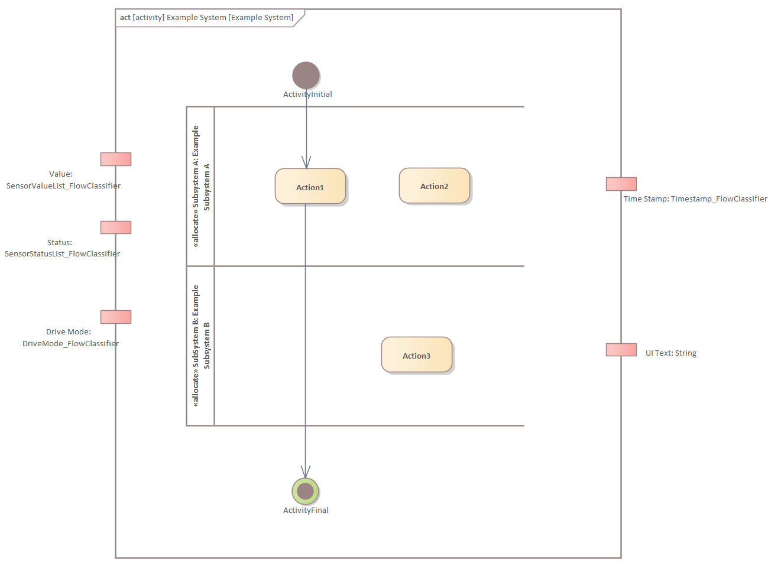
Solution
Exercise B
02_Activities_Training_Essentials_Exercise_B.qea

Slide 24
06
Adding Call behavior

Slide 25
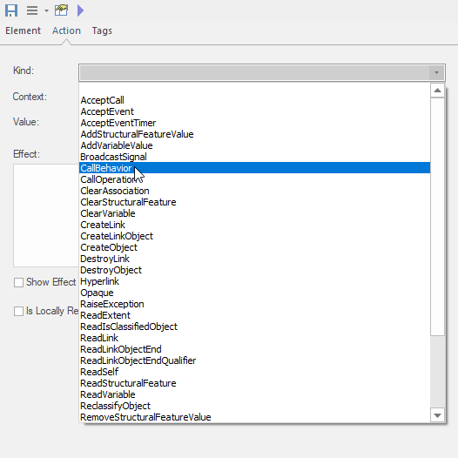
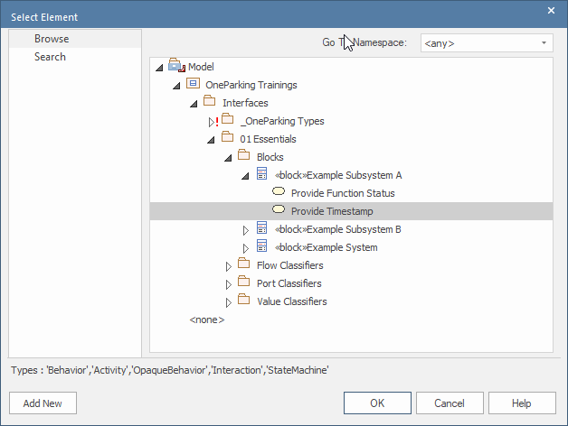
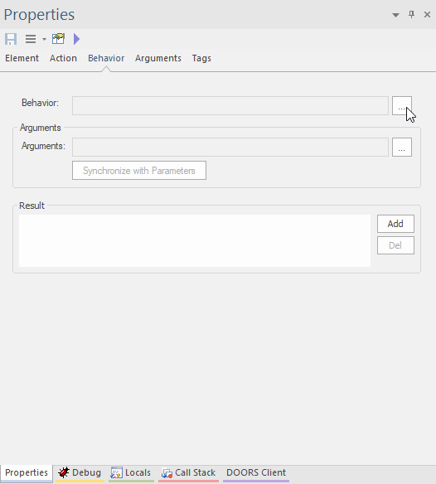
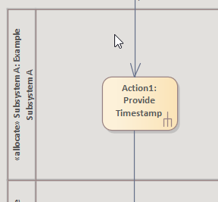
06
Adding Call behavior
01
03
Select CallBehavior as Kind in Action tab and Save (01)
Navigate to Behavior tab, click on (…) in Behavior option (02)
Set the appropriate activity ‘Provide Timestamp’ (03)
Notice a rake symbol appears for Action1 (04)
02
04

Slide 26
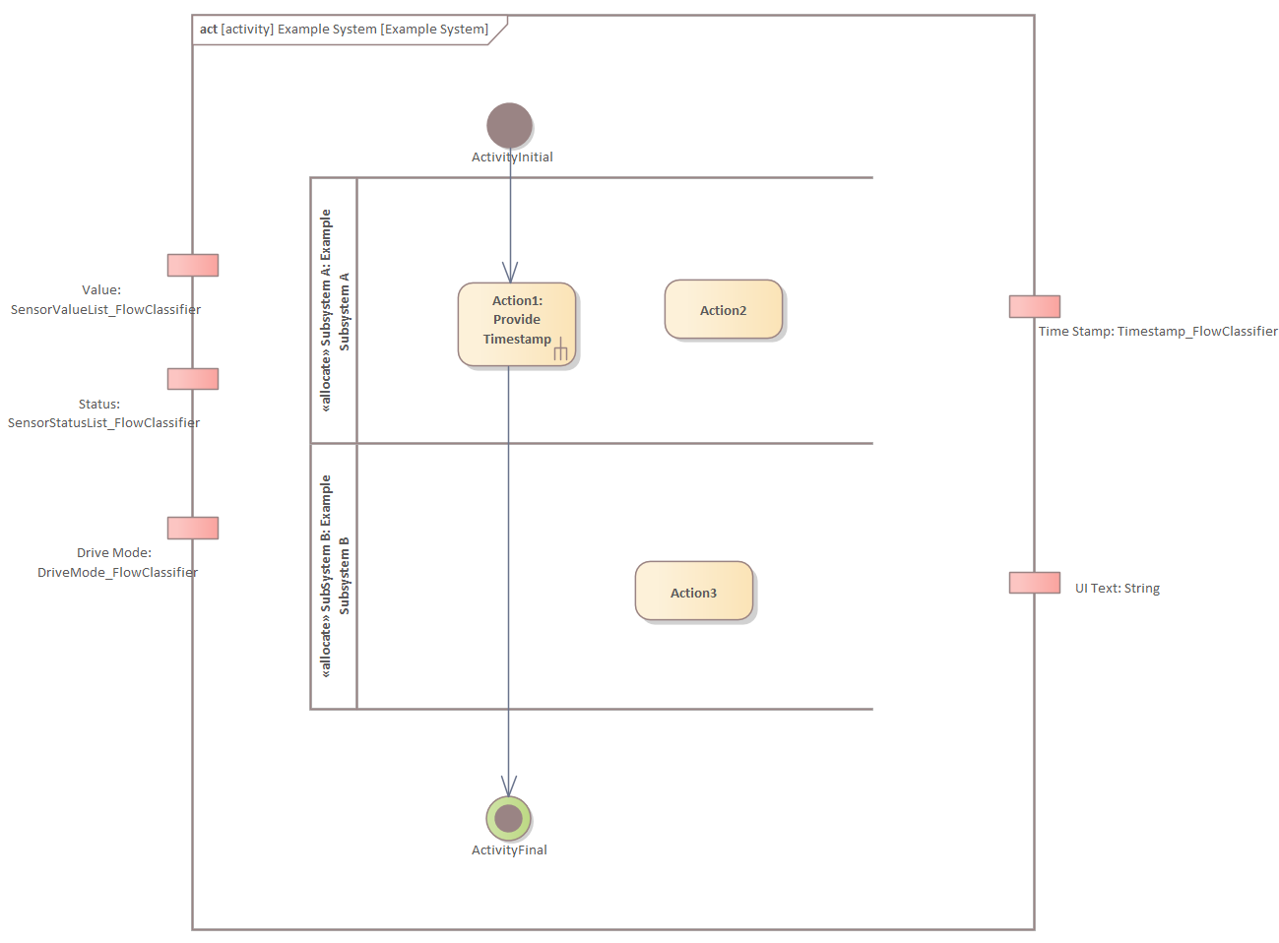
Result after Step 06
Adding Call behavior
02_Activities_Training_Essentials_Step_06.qea

Slide 27
07
Adding Action Pins from Activity Parameters

Slide 28
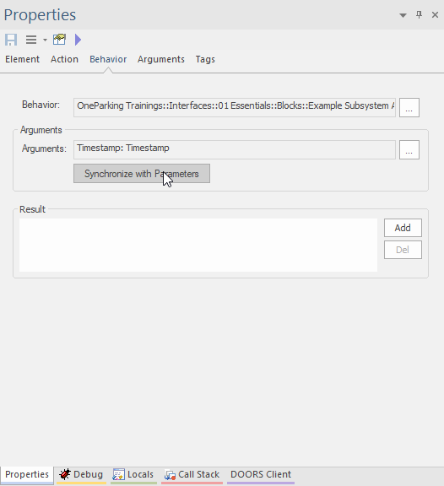
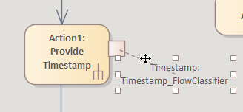
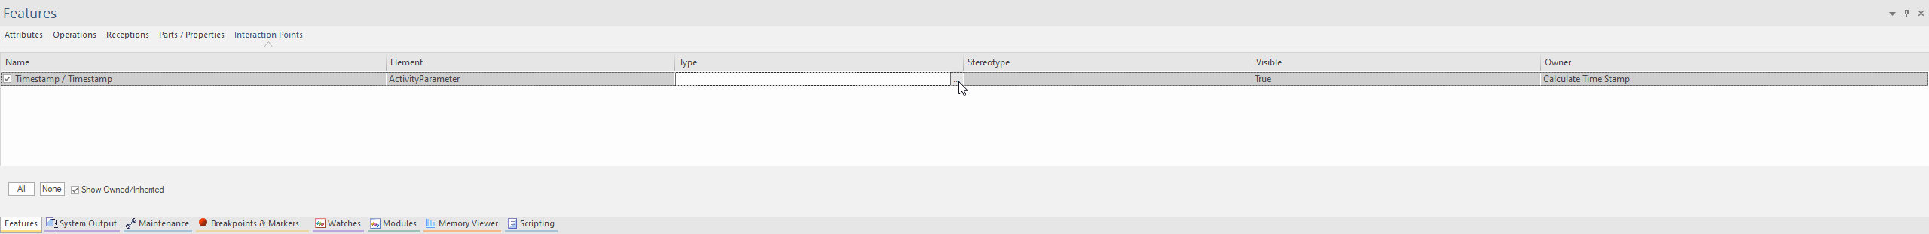
06 Part 1: Synchronizing the parameters
Adding Action Pins from Activity Parameters
01
Synchronize the Parameters (01)
Previous step results an action pin appearing on Action1 in activity diagram (02)
Navigate to Interaction Points tab in Features window, select Timestamp Activity parameter, click on (…) in Type column (03)
02
Not Used in One Parking
03

Slide 29
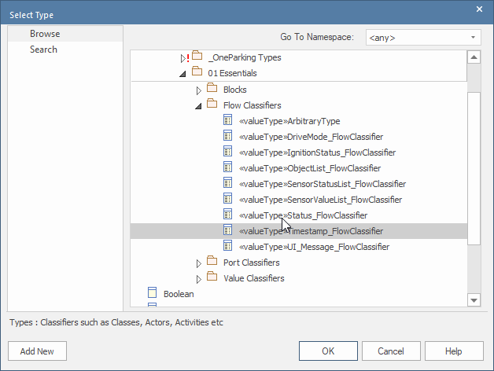
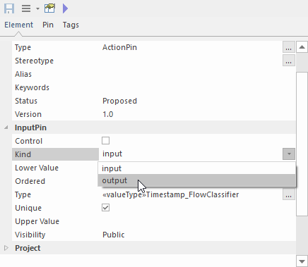
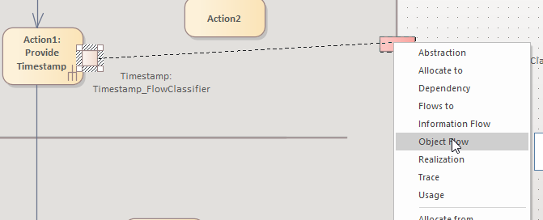
06 Part 2: Associating action pin type and establishing connections
Adding Action Pins from Activity Parameters
Set the appropriate Value Type ‘Timestamp_FlowClassifier’ (04)
Change the Input Kind as Output (05)
Connect action pin to the activity parameter, select Object Flow as connector type (06)
04
05
Not Used in One Parking
06

Slide 30
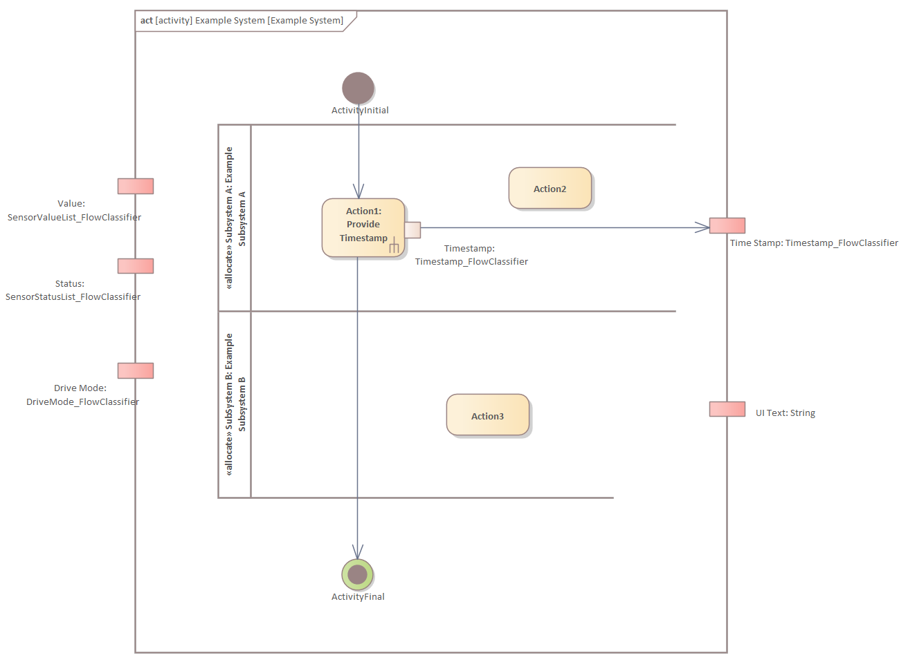
Result after Step 06
Adding Action Pins from Activity Parameters
Not Used in One Parking
02_Activities_Training_Essentials_Step_07.qea

Slide 31
C
Exercise

Slide 32
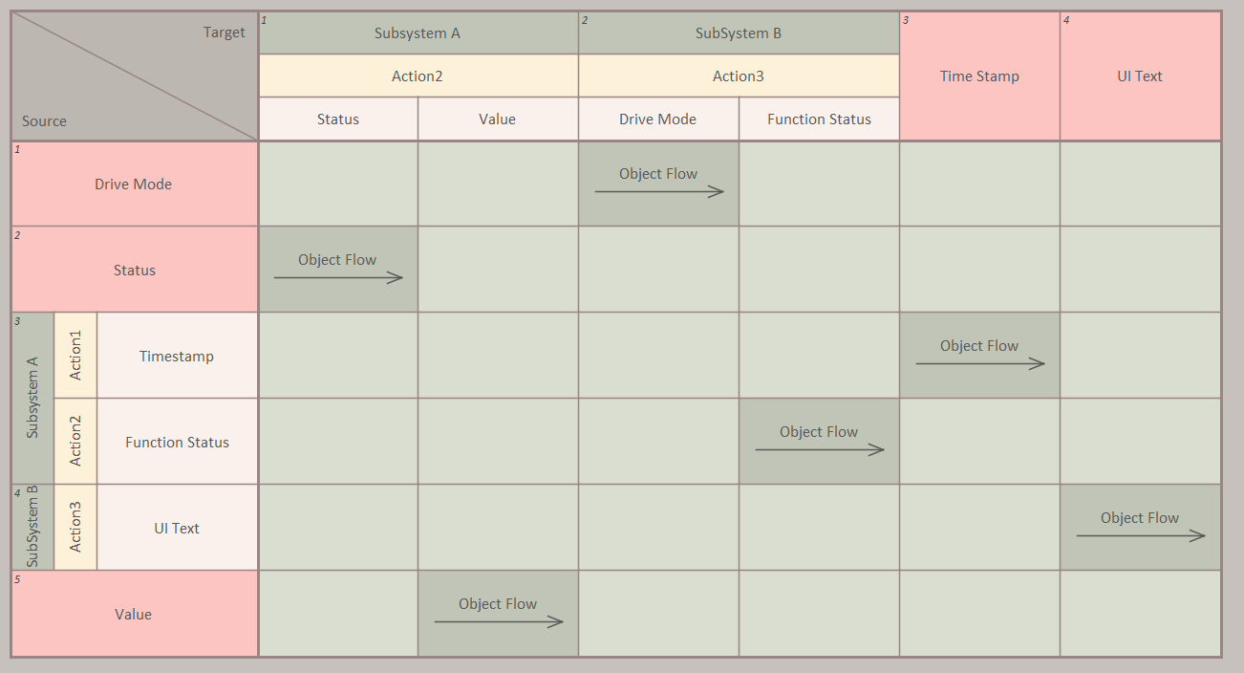
Statement
Exercise C
Add a call behavior to atomic action ‘Action 2’ to activity Provide Function Status in block Subsystem A
Add a call behavior to atomic action ‘Action 3’ to activity Evaluate Status in block Subsystem B
Add(synchronize) activity parameters of each activity to action pins of actions added above
Update the direction and type info as per activity parameter for above action pins
Connect activity parameter and action pins added above according to below table:
Solution is in the next slide along with EA file

Slide 33
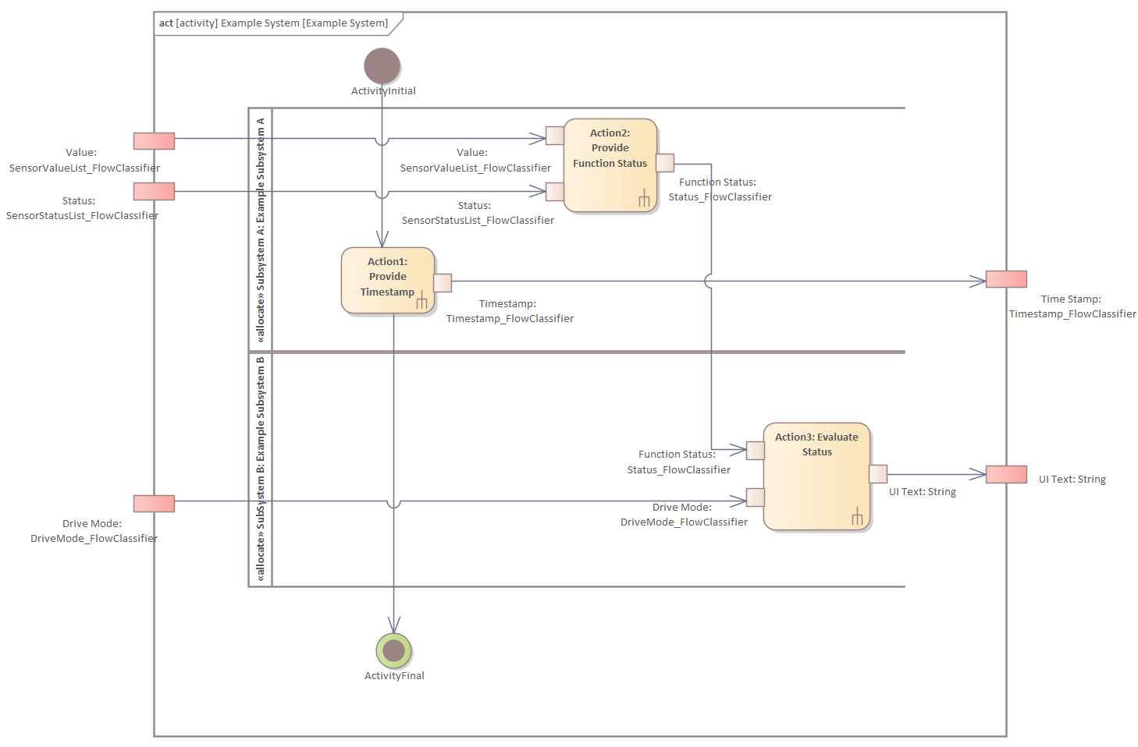
Solution
Exercise C
02_Activities_Training_Essentials_Exercise_C.qea

Slide 34
08
Adding call operation

Slide 35
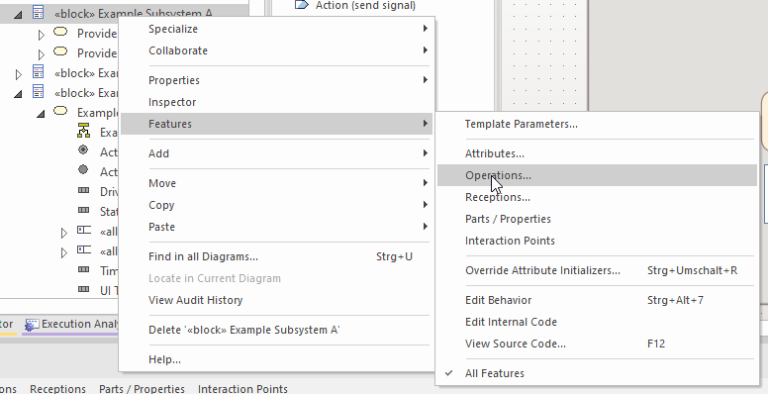
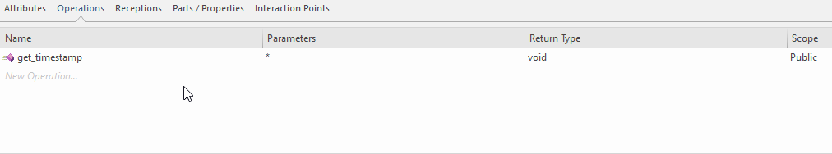
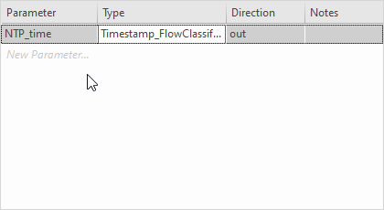
08 Part 1: Adding a new call operation
Adding call operation
Add a call operation to block Example Subsystem A (01)
Name the call operation as ‘get_timestamp’ (02)
Add a parameter as NTP_time(out) and type as Timestamp_FlowClassifier (03)
01
02
03

Slide 36
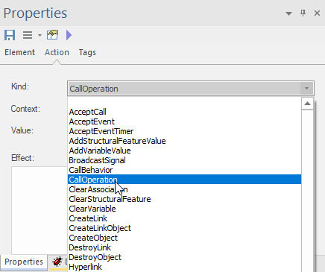
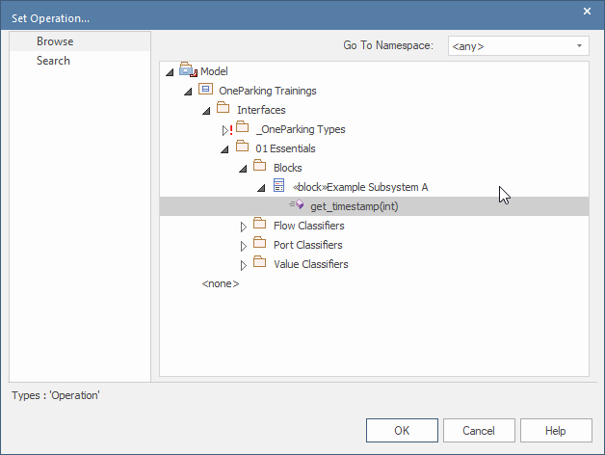
08 Part 2: Associating the call operation to action (Acquire NTP Timestamp)
Adding call operation
04
Go to Provide Timestamp activity diagram.
Select Acquire NTP Timestamp, set CallOperation as kind in action tab and Save (04)
Set the operation created in step 01 ‘get_timestamp‘ (05)
05

Slide 37



08 Part 3: Synchronizing the parameter(s)
Adding call operation
06
Synchronize the Parameter (06)
An action pin appears on Acquire NTP Timestamp in activity diagram (07)
Navigate to Interaction Points tab in Features window, select NTP_time action pin, set approproate Value Type ‘Timestamp_FlowClassifier‘ (08)
07
08

Slide 38


08 Part 4: Establishing connection(s)
Adding call operation
09
Change the input kind as Output (09)
Connect action pin to the Activity Parameter, select Object Flow as connector type (10)
NOTE: Synchronization does not consider the direction of the parameter. Default direction for an action pin is Input, So a manual check is needed for each action pin that has been synchronized.
10

Slide 39

Result after Step 08
Adding call operation
02_Activities_Training_Essentials_Step_08.qea

Slide 40
09
Adding Control Nodes

Slide 41
09 Part 1: Prerequisite
Adding Control Nodes
Go to Evaluate Status activity in Example Subsystem B, add below Actions with along with action pins:
Action4
Inputs
Function Status : Status_FlowClassifier
Drive Mode : DriveMode_FlowClassifie
Output
UI Text : String
Action5
Input
Drive Mode : DriveMode_FlowClassifie
Output
Driving Direction: Boolean
Action6
Input
Direction: Boolean
Output
Direction Text: String
Action7
Input
Direction: Boolean
Output
Direction Text: String

Slide 42



09 Part 2: Adding Fork node
Adding Control Nodes
01
Add vertical fork node(Fork) (01)
Connect activity parameter Drive Mode to Fork node added in previous step, select Object Flow as connector type (02)
Connect fork node to action pins of Action4 and Action5 (03)
02
03

Slide 43



09 Part 3: Adding Decision
Adding Control Nodes
04
Add Decision node(Drive Direction Check) (04)
Connect output action pin of Action5 to decision node, select Object Flow as connector type (05)
Connect decision node to Action6, Action7 input action pins(06)
05
06

Slide 44


09 Part 4: Adding Merge
Adding Control Nodes
07
Add merge node (07)
Connect output action pins of Action 6, Action 7 to decision node, select Object Flow as connector type (08)
08

Slide 45



09 Part 5: Adding Join
Adding Control Nodes
09
Add vertical Join node (09)
Connect Action4 output action pin & Merge Node to Join node (10)
Connect Join node to UI Text Activity parameter node, select Object Flow as connector type (11)
10
11

Slide 46

Result after Step 09
Adding Control Nodes
02_Activities_Training_Essentials_Step_09.qea

